Slide 1
DeepMind Control Suite
Github link: https://github.com/deepmind/dm_control
Publication link: https://arxiv.org/pdf/1801.00690.pdf
GREW Creative Lab

Slide 2
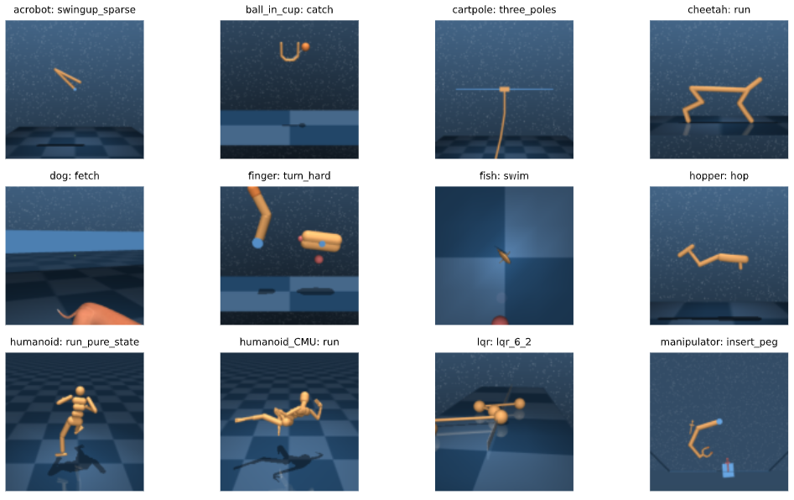
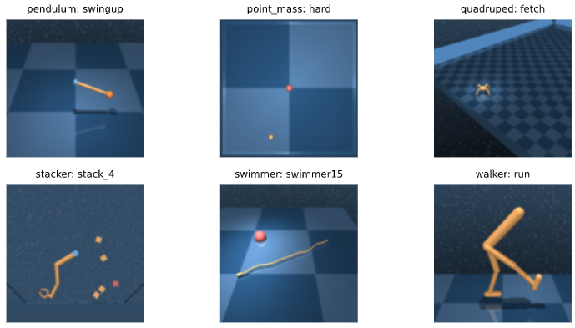
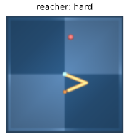
Introduction
The DeepMind Control Suite is a set of stable, well-tested continuous control tasks that are easy to use and modify.
The example views of these tasks:
Tasks are written in Python and physical models are defined using MJCF. Standardized action, observation and reward structures make benchmarking simple and learning curves easy to interpret.
GREW Creative Lab

Slide 3

Using dm_control suite
The suite module contains the domains and tasks defined
Domain is physical model (e.g. hopper)
Each domain may have different tasks. For example, the Hopper has two tasks: “stand” and “hop”.
Loading hopper by suite:
from dm_control import suite
# loading a task
env = suite.load(domain_name='hopper', task_name='hop')
spec = env.action_spec()
time_step = env.reset()
while not time_step.last():
action = random_state.uniform(spec.minimum, spec.maximum, spec.shape)
time_step = env.step(action)
GREW Creative Lab

Slide 4
Using dm_control suite
The suite module contains the domains and tasks defined
Domain is physical model (e.g. hopper)
Each domain may have different tasks. For example, the Hopper has two tasks: “stand” and “hop”.
Loading hopper by suite:
from dm_control import suite
# loading a task
env = suite.load(domain_name='hopper', task_name='hop')
spec = env.action_spec()
time_step = env.reset()
while not time_step.last():
action = random_state.uniform(spec.minimum, spec.maximum, spec.shape)
time_step = env.step(action)
GREW Creative Lab

Slide 5
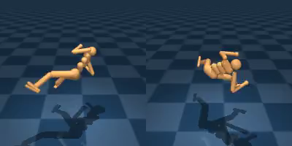
Using dm_control suite
Domain is humanoid, it has 3 tasks: “stand” , “walk” and “run”.
Loading humanoid by suite:
from dm_control import suite
# loading a task
env = suite.load(domain_name='humanoid', task_name='stand')
spec = env.action_spec()
time_step = env.reset()
while not time_step.last():
action = random_state.uniform(spec.minimum, spec.maximum, spec.shape)
time_step = env.step(action)
GREW Creative Lab

Slide 6

Rendering a model
We can render any dm_control suite domains on the MJCF by using:
from dm_control import viewer
Example to render “hopper” model on MJCF:
from dm_control import suite
from dm_control import viewer
import numpy as np
# loading a task
env = suite.load(domain_name='hopper', task_name='hop')
action_spec = env.action_spec()
# Define a uniform random policy.
def random_policy(time_step):
return np.random.uniform(low=action_spec.minimum,
high=action_spec.maximum,
size=action_spec.shape)
# Launch the viewer application.
viewer.launch(env, policy=random_policy)
If you run the above codes, the ‘hopper’ model is
automatically opened on the MJCF
GREW Creative Lab

Slide 7

Rendering a model
Example to render “hopper” model on MJCF:
from dm_control import suite
from dm_control import viewer
import numpy as np
# loading a task
env = suite.load(domain_name='humanoid', task_name='run')
action_spec = env.action_spec()
# Define a uniform random policy.
def random_policy(time_step):
return np.random.uniform(low=action_spec.minimum,
high=action_spec.maximum,
size=action_spec.shape)
# Launch the viewer application.
viewer.launch(env, policy=random_policy)
If you run the above codes, the ‘humanoid’ model is
automatically opened on the MJCF
GREW Creative Lab

Slide 8
How to use dm_control
If your OS is Linux, you can follow the github link of dm_control: https://github.com/deepmind/dm_control
If your OS is Windows, to install dm_control, do following steps:
Step 1:
Download and Install Anaconda 3 (https://repo.anaconda.com/archive/Anaconda3-2020.07-Windows-x86_64.exe)
After installing Anaconda, Use the terminal or an Anaconda Prompt and create a virtual environment with python=3.6:
conda create --name dm_control python=3.6
GREW Creative Lab

Slide 9
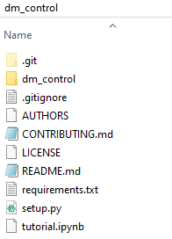
How to use dm_control
Step 2:
Download dm_control files from https://github.com/deepmind/dm_control, and extract it a place where you want.
After extracting files, go to the path of dm_control
To install dm_control write:
pip install dm_control
or
pip install .
GREW Creative Lab

Slide 10
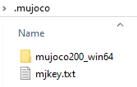
How to use dm_control
Step 3:
This step mujoco key.
Donload mujoco200 win64 from https://www.roboti.us/index.html. Also, download mjkey.txt (mujoco key).
Open a folder called “.mujoco” inside of your user name folder. After downloading mujoco200, extract it into “.mujoco”.
Place mjkey.txt into “.mujoco” folder, also place it into “.mujoco/mujoco200_win64/bin”
GREW Creative Lab

Slide 11
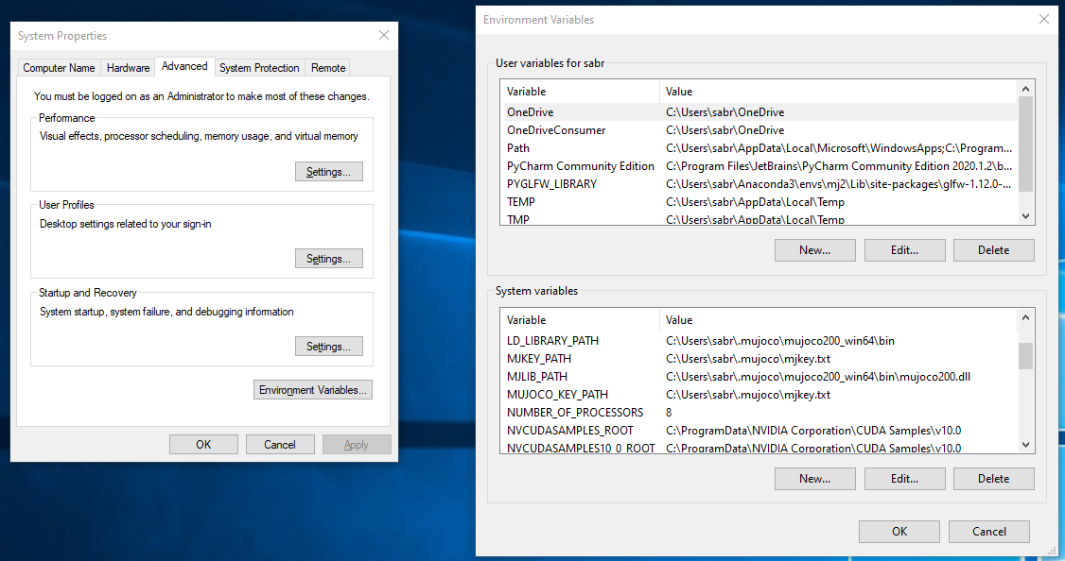
How to use dm_control
Step 4:
Go to “Edit the system environment variables” from Windows button, do calling mujoco key and libraries as following image:
GREW Creative Lab
Abduraimjonov Abdurakhmon

Slide 12
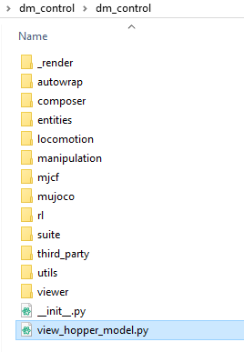
Testing after installation
If you finish 4 installation steps, you can use dm_control.
To test it, create a python file, called view_hopper_model.py inside dm_control as bellow.
from dm_control import suite
from dm_control import viewer
import numpy as np
# loading a task
env = suite.load(domain_name='hopper', task_name='hop')
action_spec = env.action_spec()
# Define a uniform random policy.
def random_policy(time_step):
return np.random.uniform(low=action_spec.minimum,
high=action_spec.maximum,
size=action_spec.shape)
# Launch the viewer application.
viewer.launch(env, policy=random_policy)
Write these codes inside view_hopper_model.py
GREW Creative Lab
Abduraimjonov Abdurakhmon

Slide 13
Testing after installation
Activate your dm_control environment from anaconda. To run
from dm_control import suite
from dm_control import viewer
import numpy as np
# loading a task
env = suite.load(domain_name='hopper', task_name='hop')
action_spec = env.action_spec()
# Define a uniform random policy.
def random_policy(time_step):
return np.random.uniform(low=action_spec.minimum,
high=action_spec.maximum,
size=action_spec.shape)
# Launch the viewer application.
viewer.launch(env, policy=random_policy)
Write these codes inside view_hopper_model.py
GREW Creative Lab
Abduraimjonov Abdurakhmon

Slide 14
Testing after installation
To run view_hopper_model.py file, write:
python view_hopper_model.py
After running, you will see a view like below:
GREW Creative Lab
Abduraimjonov Abdurakhmon

Slide 15
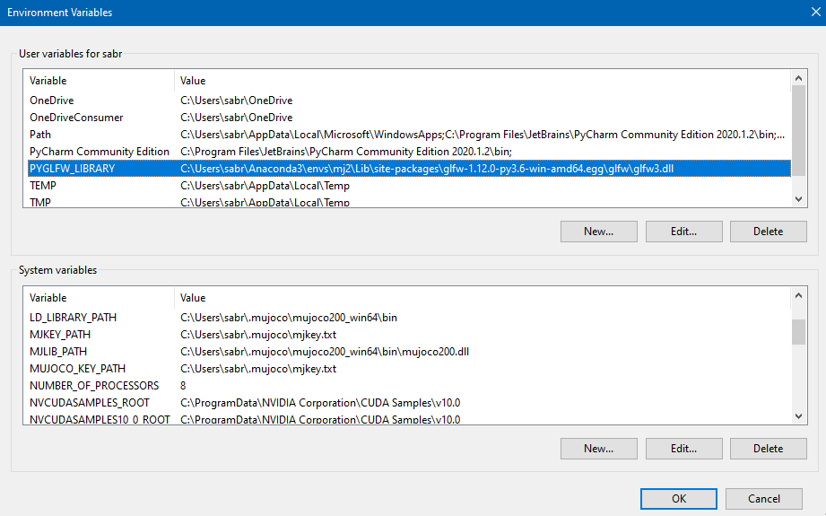
Rendering library
Note:
If you don’t get a rendering result like in pervious page, you should install GLFW library and connect it
to your Environment Variables as below:
GREW Creative Lab
Abduraimjonov Abdurakhmon

